Slide 1
Instructional Techniques
CFS
9
Second Edition
Updated July 2025

Slide 2
Adult Learner Characteristics
SELF-CONCEPT
MOTIVATION TO LEARN
1
CHARACTERISTICS
OF ADULT
LEARNERS
5
2
4
ADULT LEARNER EXPERIENCE
ORIENTATION
TO LEARNING
3
READINESS TO LEARN
SM
9-3 to
9-4

Slide 3

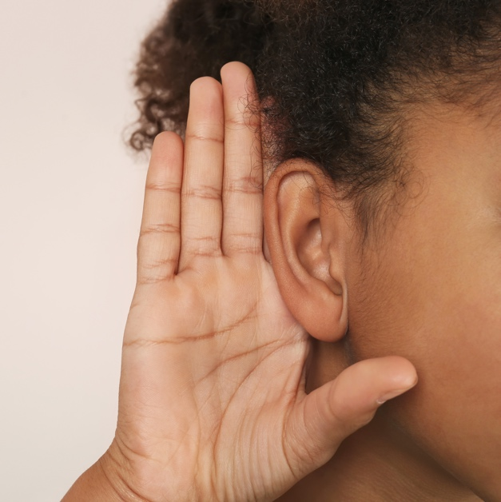

The Learning Channels
VISUAL
See it
AUDITORY
Hear it
KINESTHETIC
Do it

Slide 4
Active Training Techniques
Use Visual Aids
Highlight
Important Point
Gain Attention
Move Around
Relate
Training to
Real Life
Ask Your Audience Questions
Listener
(Hearer)
Attention
Demonstrate Expertise
Respond to Questions
SM
9-5

Slide 5
Facilitating Discussion
Use a variety of techniques
Know best practices for effectiveness
DON’T vs
DO
SM
9-6

Slide 6
Demonstrating Expertise
DON’T
DO
Believe you are
the ultimate subject matter expert, or
Fail to prepare yourself as a subject matter expert
Remember:
It is OK not to know everything
It is OK to be imperfect as an instructor
Facilitate learning, rather than deliver it

Slide 7
Relating Training to Real Life
DON’T
DO
Be afraid to ask participants to share their real-life challenges in the class
Add your personal stories for interest or to highlight a point
Remember client conversations are confidential

Slide 8
Gaining Attention
DON’T
DO
Forget that you are not the focus of the training; you are only the facilitator
Use your presentation skills to capture student attention with something novel, a story, a visual, animation, question, or small reward

Slide 9
Using Visual Aids
DON’T
DO
Use PowerPoint to:
Show every word you have to say
Read from the screen
Use PowerPoint to:
Focus the conversation
Highlight points
Illustrate models

Slide 10
Highlighting Important Points
DON’T
DO
Insist on delivering every point you believe should be made
Use memory aids for important points, for example:
Start with the most important content
Repeat it and relate it
Provide organizers like outlines, flowcharts, acronyms, and chunking

Slide 11
Using Movement in the Classroom
DON’T
DO
Stand in one place in the classroom
Be afraid to go close to participants
Move close to students
Look directly at each participant throughout the class—eye contact is important

Slide 12
Using Questions to Generate Discussion
DON’T
DO
Be afraid to:
Question what participants say
Encourage others to question you
Call on specific participants
Use effective questioning, for example:
Ask open-ended questions
Ask follow-up questions to participants’ answers
Reflect answers to other participants

Slide 13
Motivate Your Learners
Create useful and relevant learning experiences
Facilitate exploration
Use HUMOR!
Chunk information
What’s in it for me? (WIIFM)
Let them make mistakes!
Wrong answers encouraged
Are your visual
aids interesting?
Use emotion, be passionate about your topic
SM
9-7

Slide 14
Visual Aids
Improve audience understanding and memory
Serve as notes
Provide clearer organization
Facilitate more eye contact and motion by the speaker
Contribute to speaker credibility
Supplement facilitation key points
SM
9-9 to
9-10

Slide 15
Handling Classroom “Personalities”
Recognizing disruptive personalities
Types of disruptive behavior
Negative effects on the class
Strategies for handling “unique” students
“I’m not difficult, I’m just unique.”
SM
9-11 to
9-12

Slide 16
The Driver Profile
AKA | The “Know-It-All”
Typical Behavior | Has something to say about everything Concerned with exactness and accuracy
Classroom Effect | Detracts from the conversation Limits times for others to contribute May intimidate others into silence

Slide 17
Addressing Driver Behavior
Strategies | Ask for participation from a different and specific part of the room Decline to call on “the assistant” and state that you’d like to hear from other class members Ask for participation from those who haven’t been involved yet
What to Say
“We need everyone to have the opportunity to bring their thoughts into the conversation.”

Slide 18
The Analytical Profile
AKA | “On the other hand”
Typical Behavior | Offers an opposing point of view Challenges the status quo
Classroom Effect | Facilitator must be careful not to overreact Has a potential to escalate into confrontation and distract from classroom agendas

Slide 19
Addressing Analytical Behavior
Strategies | Set a tone in the classroom that is welcoming of diverse opinions Understand that diversity can contribute to fruitful discussion Ask others to share other points of view
What to Say
“Some ideas may seem off-putting, at first, but I encourage you to bring your thoughts into the conversation.”

Slide 20
The Expressive Profile
AKA | The “Over-sharer”
Typical Behavior | Shares too much, too often Processes learning by talking (“thinking out loud”)
Classroom Effect | Limits ability of others to participate Over-sharing of personal details may cause others to feel uncomfortable

Slide 21
Addressing Expressive Behavior
Strategies | Encourage conversation from others Use a “go around” the room strategy to call on various class members Regularly remind the class that hearing from a variety of participants will enrich learning
What to Say
“Thank you for your insight. It is very important to the success of the class that everyone has opportunities to contribute.”

Slide 22
Practically Perfect Presentation Checklist
Logistics
Speaker Analysis
Audience Analysis
Message Analysis
Opening Remarks
Closing Remarks
Questions and Answers
SM
9-13 to
9-14

Slide 23

Instructional Techniques Video

Slide 24

Instructional Techniques Application
Each group will receive a scenario
Groups will have 15 minutes to present
Each group member must present during the exercise
Groups must discuss “Key Points”
Limit audience interruptions
Feedback will be received at the end of the exercise
HAVE FUN!
SM
9-15

Slide 25
Curriculum Resources
Training Techniques: Student Manual CFS Chapter 9 Instructional Techniques
Training Curriculum:
  Touchpoint Curriculum
  FINRED Learning Resource Library
  Personal Financial Manager at your Installation Military and Family Support Center

